Slide 1



Charity project

Slide 2
Product purpose
The purpose of the project is to improve the efficiency and effectiveness of the charity organization’s work as it facilitates the registration and tracking of cases for a charity organization.

Slide 3
Product Scope
The scope of the project includes the following:
The system allows admins to register new cases to the charity organization, register new inspectors to the system and assign case to specific inspector.
The system allows inspectors to access information about assigned cases and create reports about the cases they are working on.

Slide 4
Product Perspective
The newly introduced system will overcome the problems that have occurred due to the current manual system .
It will provide an easy access to the system and will be designed to be maintainable and easy to update over time, with appropriate documentation and support.
. It will use a database to store information about cases and people involved, and will have a user interface for admins and inspectors to access and update that information..

Slide 5
Product Functions
Case registration.
Inspector registration.
Case assignment.
Case review
Report creation.

Slide 6
User Classes
inspectors
Admins

Slide 7
Characteristics of User Classes
Admins: Admins are the primary users of the system and are responsible for managing cases, registering new cases, registering inspectors, and assigning cases to inspectors.
Inspectors: Inspectors are users of the system who are responsible for reviewing cases that have been assigned to them and making reports about those cases.

Slide 8
Benefits of the system
increasing efficiency of work.
better tracking of cases, and improved reporting capabilities.
Enabling them to better serve those in need and make a greater positive impact on the community.
Better communication and collaboration

Slide 9
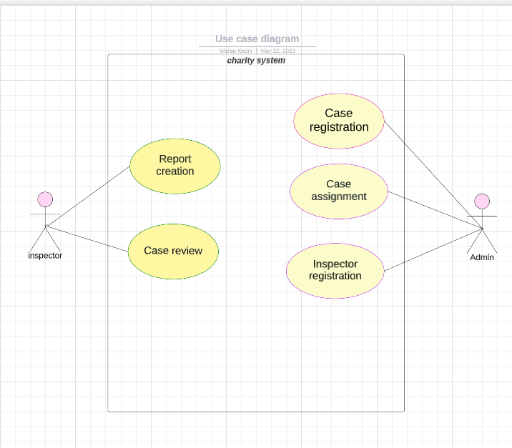
Use case diagram

Slide 10
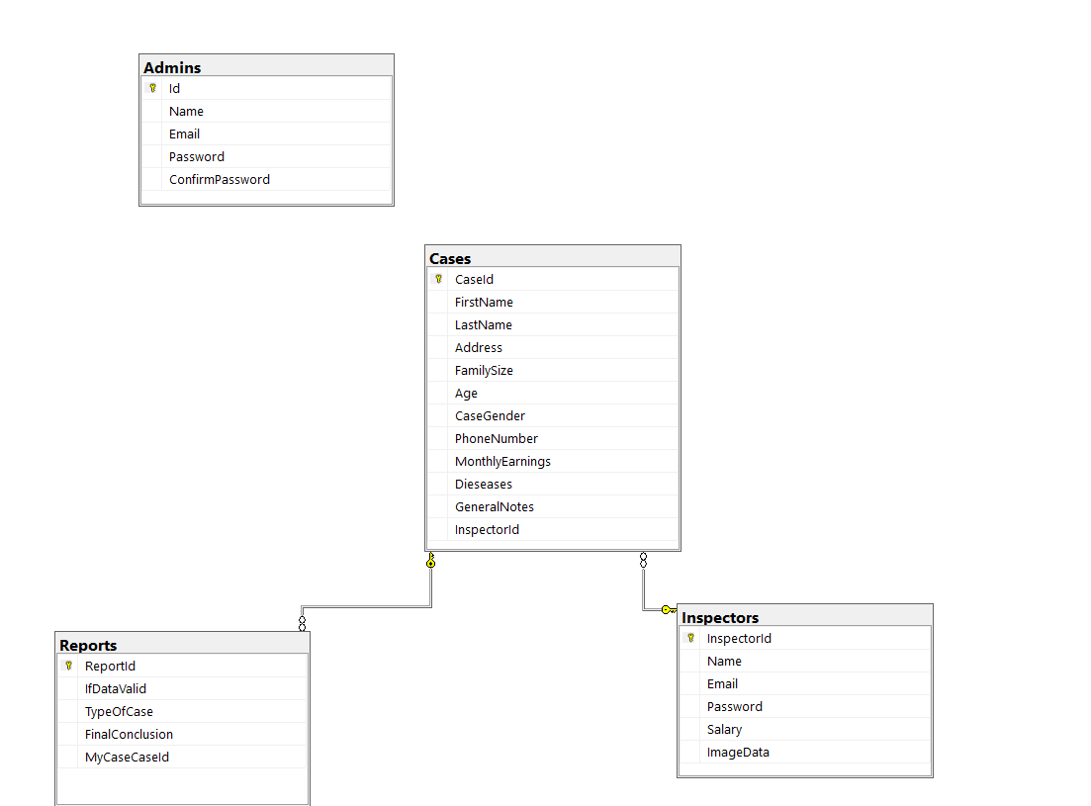
ER Diagram

Slide 11
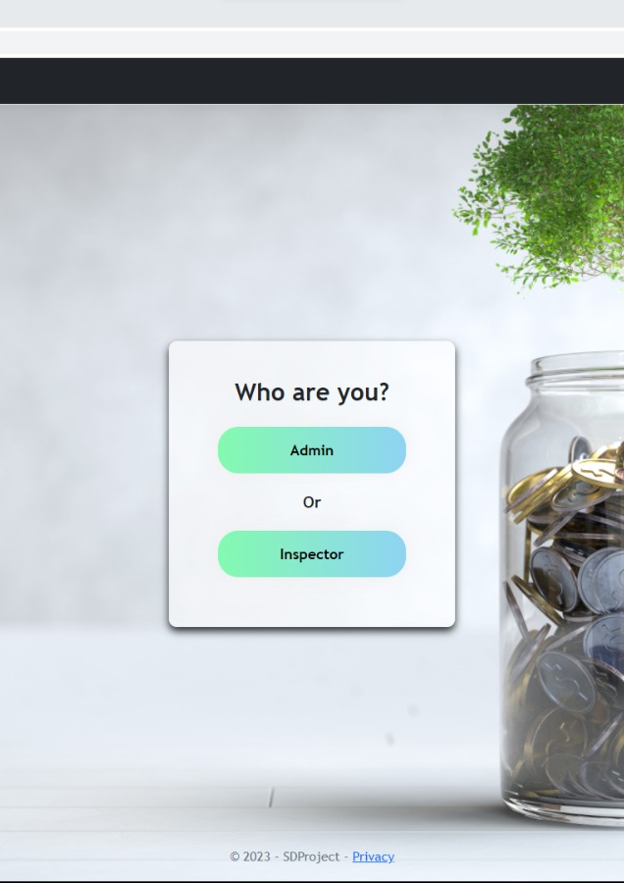
User interface
This is the home page of the project .
You can select one choice of two:
Admin.
Inspector.

Slide 12
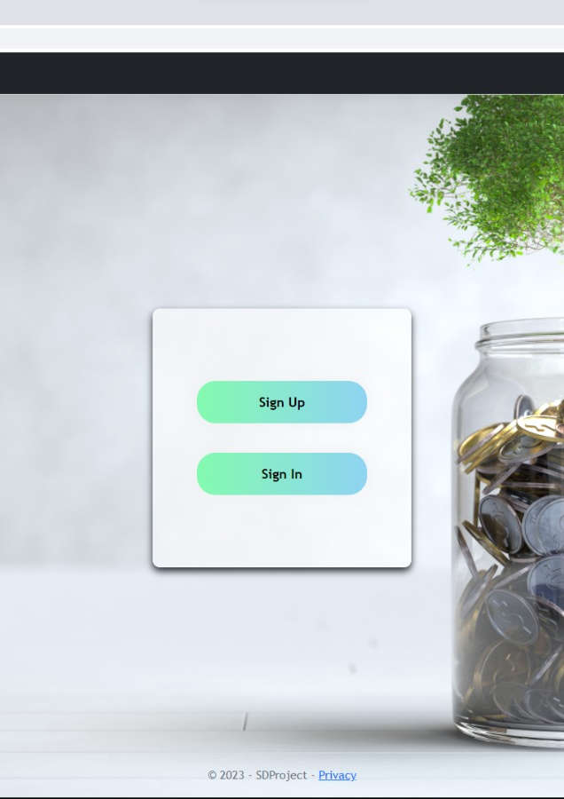
User interface
When you choose as an admin you have two choices either sign up or sign in

Slide 13
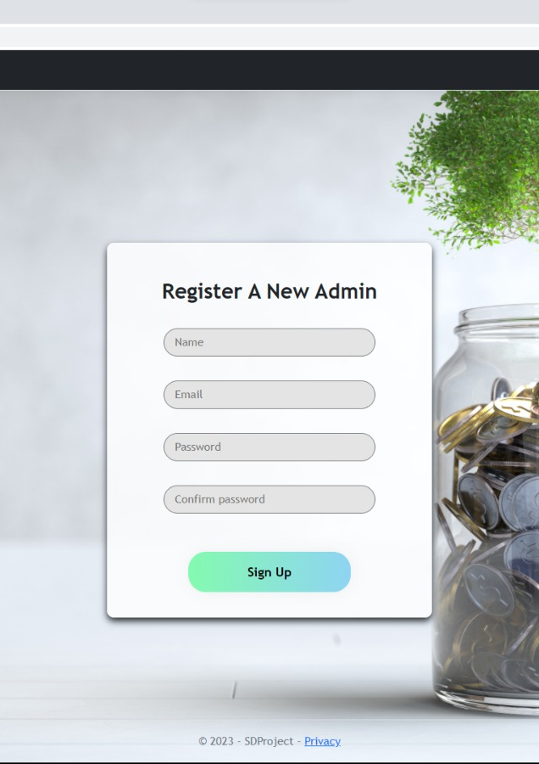
User interface
In the admin side when you choose sign up ,you will find this page to create an account
Write an appropriate email and password then click sign up to finish

Slide 14
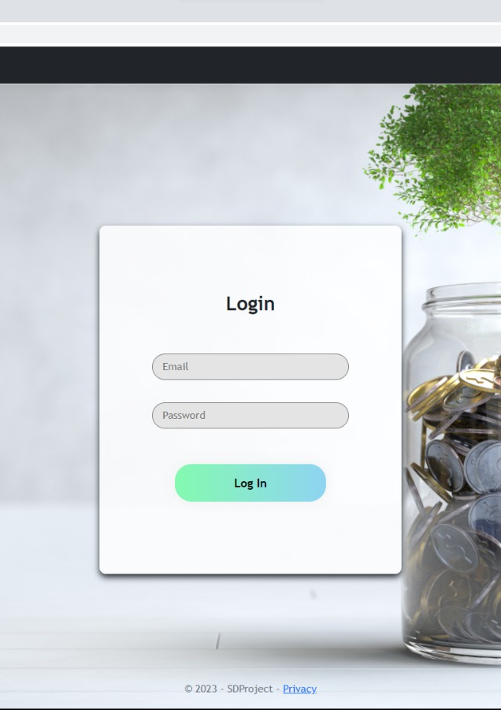
User interface
In case you have an account you can click on "sign in"
Then write your email and password to log in.

Slide 15
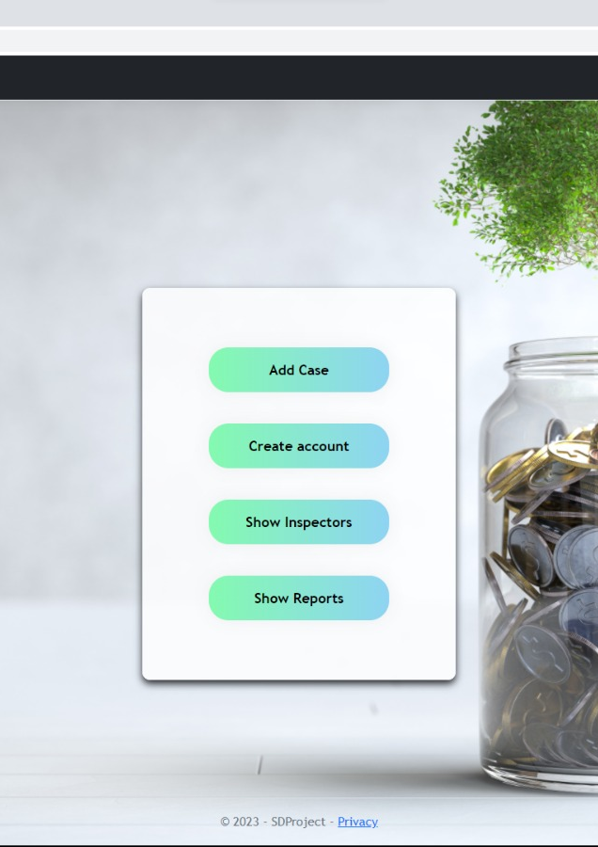
User interface
After log in you can do one of the following:
Add a new case.
Create account for inspector.
Show all inspectors in the system.
Show all reports created by inspectors.

Slide 16
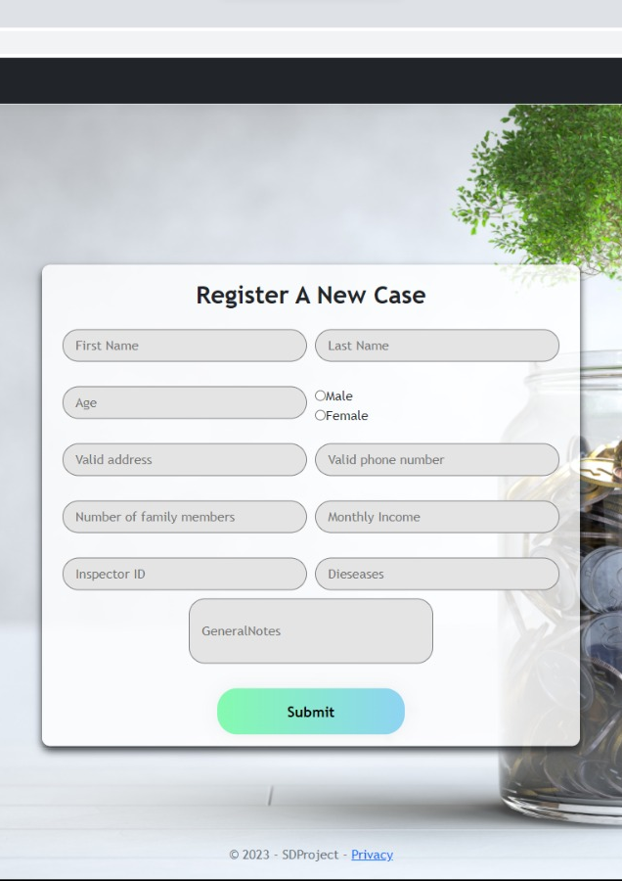
User interface
When you click on "add case" ,you will find this form to enter all information about the case.

Slide 17

User interface
When you click on "create account" ,you will find this form to enter all information about the new inspector.

Slide 18
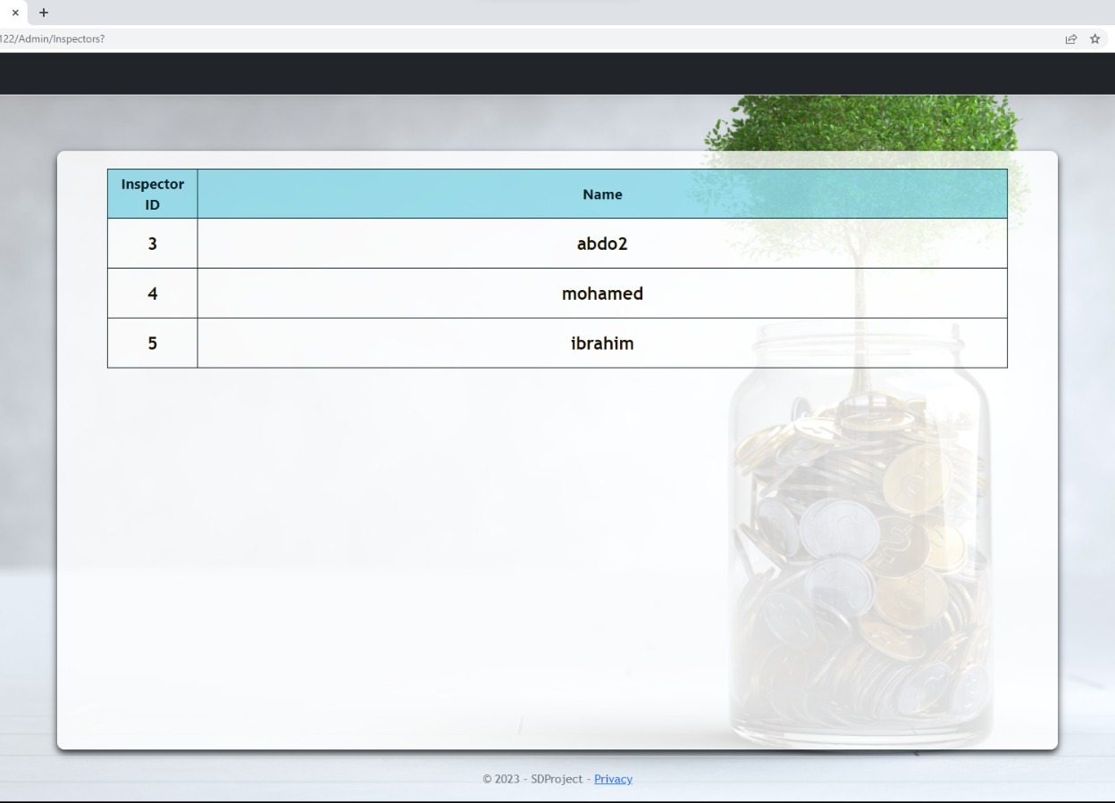
User interface
When you click on "show inspectors" ,you will see all the inspector in the system.

Slide 19
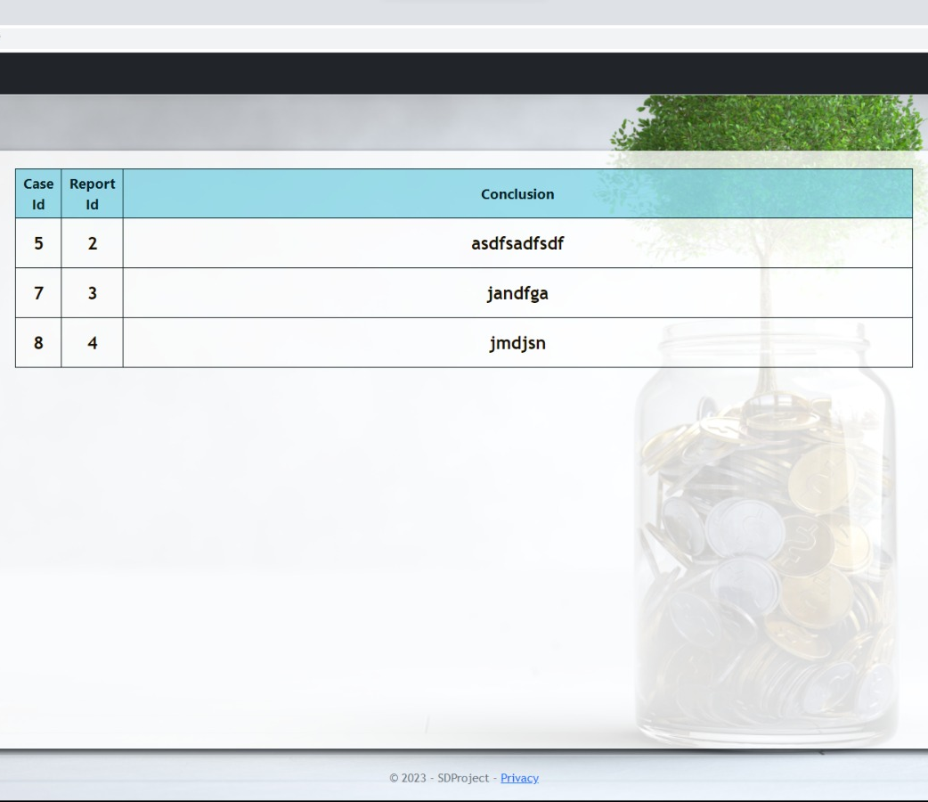
User interface
When you click on "show reports" ,you will see all the reports in the system.

Slide 20

User interface
When you choose as an inspector you have two choices either Cases or Reports.

Slide 21
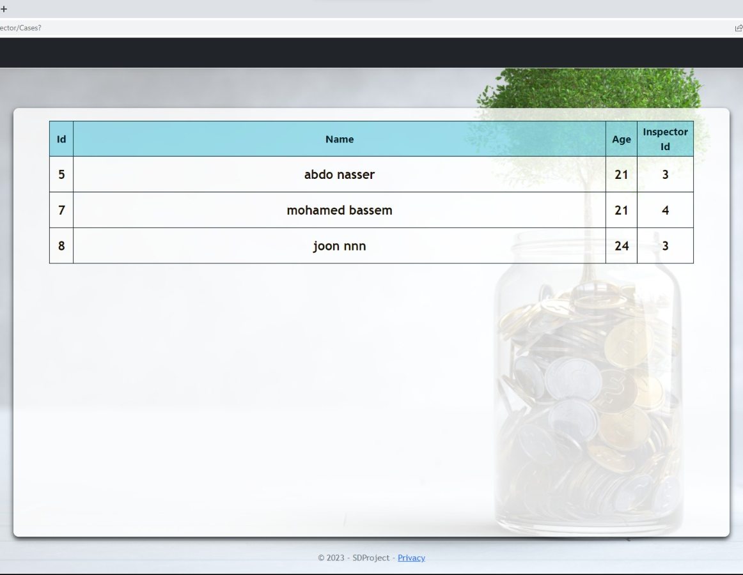
User interface
Here as an inspector can see all cases assigned to you and review them.

Slide 22
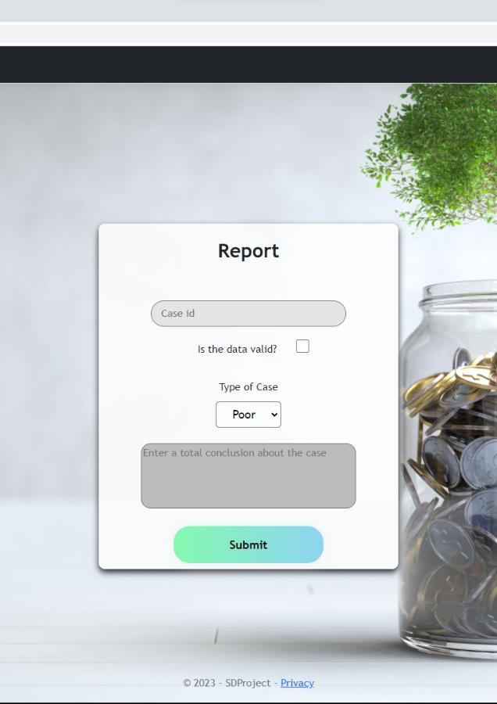
User interface
Here you can create a report for the case you have reviewed.

Slide 23

Thank you

